Slide 1
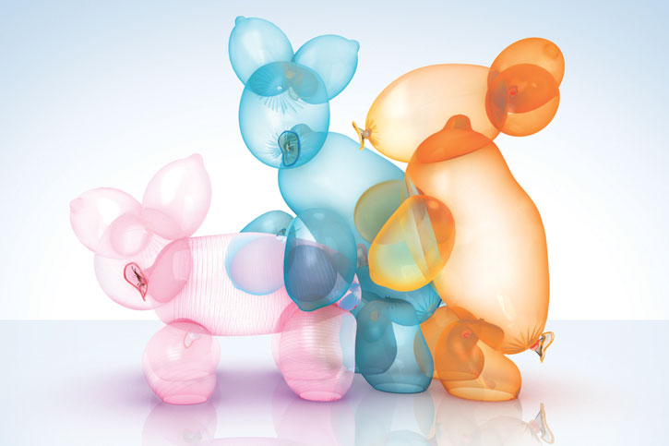
Contraception
Alastair Rankin
Obstetrics & Gynaecology Block
November 2010

Slide 2
Contraception
Family planning is an integral service in the provision of health promotion.
The health and social benefits of effective contraception are immense
Similarly immense is the different types of contraception that are available.
So what makes a good contraceptive?

Slide 3
The Ideal contraceptive
100% effective
100% reversible
Free of adverse effects
Convenient and unrelated to intercourse
Protective against STIs
Have other non-contraceptive benefits
Require little on-going medical input.

Slide 4
Important history
LMP (are they pregnant now?)
Unprotected sexual intercourse (UPSI) (could they be about to get pregnant?)
Past contraception (what worked well/did not work well in the past?)
Smoking/ BMI/ DVT/ Migraines (esp with aura)
→ may not be suitable for COCP
STIs – may need to advise barrier contraceptive use
Acne (would benefit from Dianette)
PH or FH of breast Ca – COCP increases risk
Current meds – interactions.
Future fertility plans

Slide 5
Types of contraception
Traditional – abstinence, coitus interruptus
Natural – rhythm, breast-feeding
Barrier - Condom, femidom, diaphragm, cap
Hormonal – COCP, POP, patch, depo
LARC – implanon, mirena, copper coil,
Irreversible – vasectomy, sterilisation
Emergency – levonorgestrel, copper coil
New – nuva ring, gel
Dianette – antiandrogen effect – good for acne

Slide 6
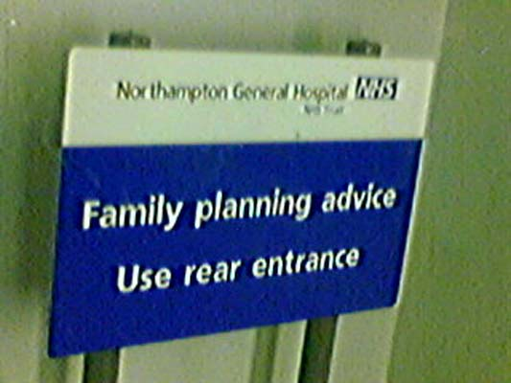
Traditional and natural methods
Abstinence
Coitus Interruptus
“a heard of wild horses couldn’t get me to pull out”
Rhthym Method
Aims to identify the infertile times in a women’s cycle
Can be up to 98% effective
if use basal body temp and cervical mucus monitoring to determine ovulation

Slide 7
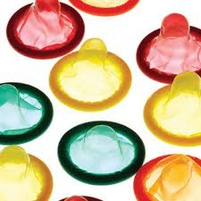

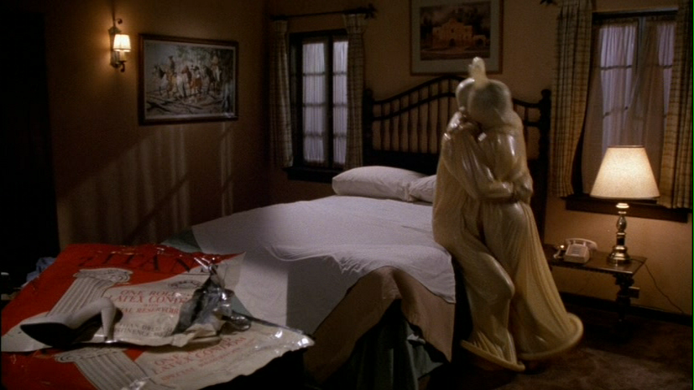
Barrier Methods
Condoms
98% effective with perfect use (very user dependant)
+’s: cheap, widely available, PROTECT AGAINST STIs
-’s: don’t work if you don’t wear one, interrupt sex, allergy, decrease sensation, can be damaged by oil-based products (cannestan, baby-oil), user dependent, can fail (break), don’t protect against all STIs
“just do it already”

Slide 8
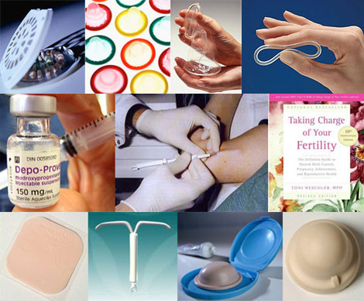
Barrier contraception (cont’d)
Diaphragms
Rarely used now
Lie across the cervix
Must be used with spermicide
Keep in for 6 hours after sex
User dependent
Protect against some STIs
Initially fitted by a doctor
Femidoms
Caps

Slide 9
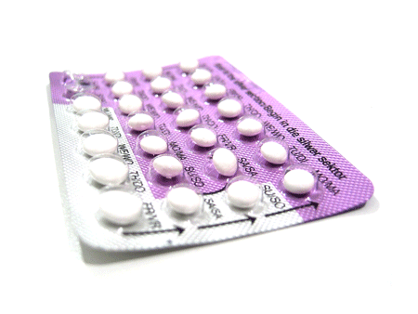
hormonal
Combined Oral contraceptive Pill (COCP)
Contains oestrogen and progestogen
Take for 3 weeks out of 4
If taken correctly 99% effective
Mode of action
Prevents ovulation – stops FSH and LH surge
Makes endometrium inhospitable
Increases viscosity of cervical mucus
Contraindications
Interactions

Slide 10
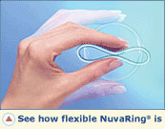
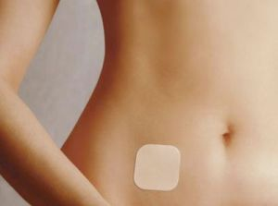
Hormonal (cont’d)
Also available as…

Slide 11
Hormonal (cont’d)
The progestogen only pill (POP)
Taken every day
99% effective with perfect use
However more user dependent (12 hour window)
Good for patient CI’d to COCP
Primarily works by affecting cervical mucus
Prevents ovulation in 25%
-’s: menstrual irregularities (due to lack of oestrogen)

Slide 12
Hormonal (cont’d)
Depoprovera
Progesterone injection
Given IM into buttock
Lasts 14 weeks
>99% effective
Disadvantages:
Cannot reverse treatment if side effects (lasts 14 weeks)
Delay for fertility to return can be up to 18 months!
Weight gain (↑ appetite)
Oesteopaenia (reversible) – DXA scan at 5 years
→ Injection has now been superseded by the implant.

Slide 13
Long Acting reversible Contraception
Implannon
Implant inserted subcutaneously
under local into upper arm
Very effective contraceptive
Only reported failures due to error in insertion
Lasts 3 years
s/e: 1 in 6 will have irregular bleeding that persists (1 in 5 will be amenorrhoeic). Acne, mood changes, weight gain all possible.

Slide 14
Long Acting reversible Contraception
Mirena Coil
Aka levonorgestrel releasing intrauterine system (IUS)
Sits in uterine cavity and continually releases small dose of hormone
Produces high concentration within the uterus
Lasts 4-5 years
Very effective
Failure rate = 1 in 200 per year (= female sterilisation)
Can cause irregular bleeding for first 6 months
Cis: abnormal uterine cavity (eg large fibroids)

Slide 15
Long Acting reversible Contraception
The Copper coil
Copper containing Intrauterine Device (IUD)
Prevents implantation
Copper is spermicidal
>99% effective
Lasts 10 years!
Cheap, hormone free
Most failures with poor insertion
-’s:
Increases risk of ectopic (if fall pregnant).
Can increase pain and heaviness of periods
Expulsion – 1 in 300
CIs: abnormal uterine cavity, copper allergy, menorrhagia

Slide 16
Irreversible sterilisation
Female sterilisation
1 in 200 lifetime failure
Failure results in ectopic
Commonly used in couples over 40
Fallopian tubes are clipped
Essentially irreversible
Small laparoscopic procedure
However still risks associated
More complex if previous C-sections
*Always advise patient that this is not the safest option!

Slide 17
Irreversible sterilisation
Vasectomy
Can be done under local
Most effective - 1 in 2000 lifetime risk – due to recanalisation
Permanent division of the vas deferens
→ no sperm in ejaculate
Does not affect ejaculate colour or volume

Slide 18
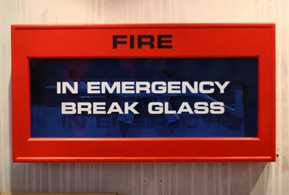
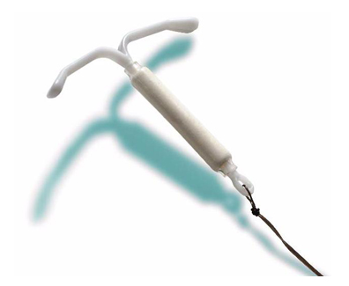


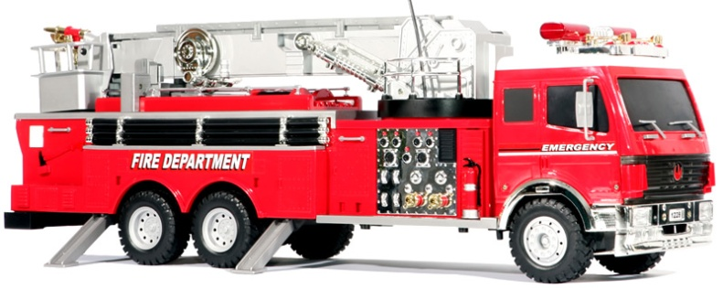
Emergency Contraception
Levonelle:
Contains progestogen
Action varies depending on point in cycle
Effective up to 72 hours after UPSI
Copper coil
More effective
Works for up to 5 days after UPSI

Slide 19
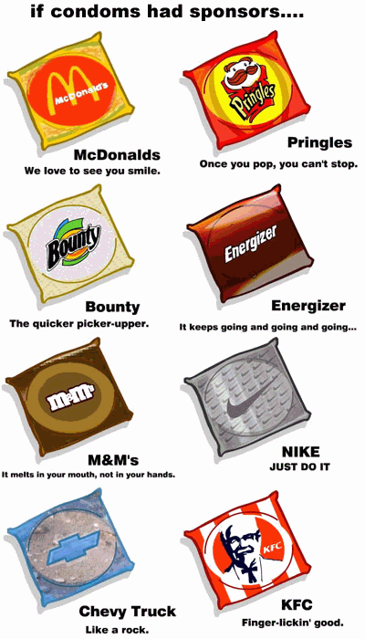
Thank you
Any questions?

